Slide 2
Peer and Self-Assessment Series

Slide 3
Safety in the Lab

Slide 4
Do not enter the laboratory without permission.

Slide 5
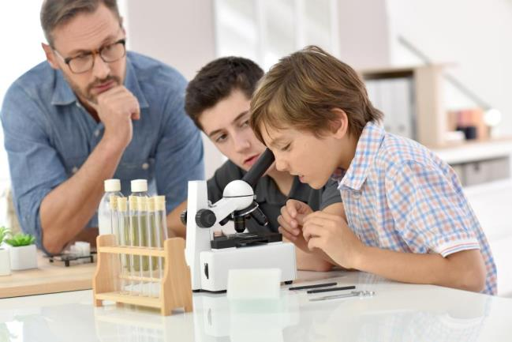
2. Do not use any equipment unless permitted to do so by your teacher.

Slide 6
3. Make sure you know exactly what you are supposed to do. If in doubt, ask your teacher.

Slide 7
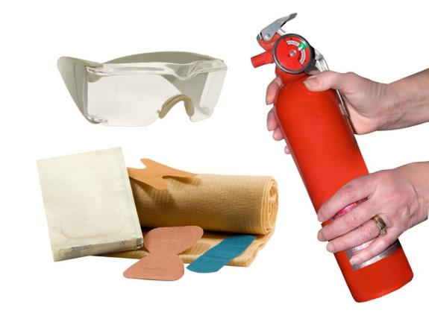
Make sure you know the position of all
safety equipment
in the laboratory,
e.g. the fire
extinguishers,
first aid
equipment, etc.

Slide 8
5. Always wear eye protection or gloves when instructed
to do so.

Slide 9
6. Long hair must be tied back during practical classes.

Slide 10
7. Place your bag and other personal items safely out of the way.

Slide 11
8. Never handle any chemicals with bare hands.

Slide 12
9. Nothing must be eaten, tasted or drunk in the laboratory.

Slide 13
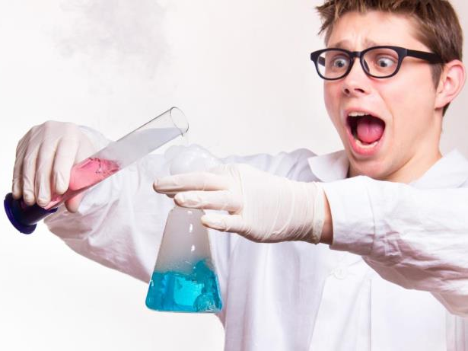
10. Any cut, burn or other accident must be reported at once to your teacher.

Slide 14
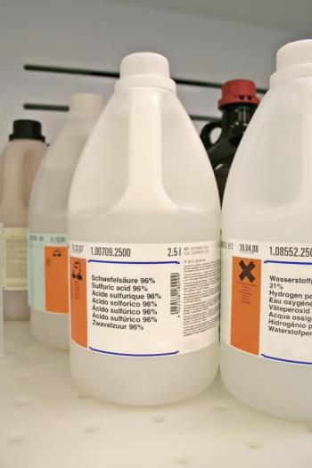
11. Always check that the label on the bottle is exactly the same as the material you require. If in doubt, ask your teacher.

Slide 15
12. Any chemical spilled on the skin or clothing must be washed at once with plenty of water and reported to your teacher.

Slide 16
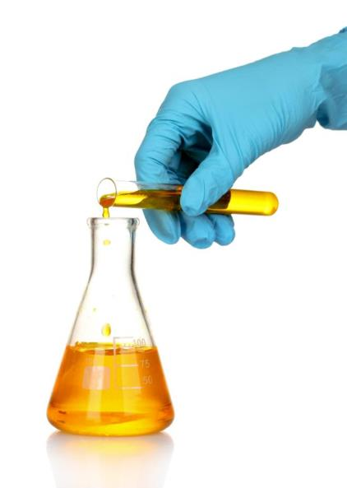
13. Test tubes should never be overfilled. When heating a test tube ensure that the mouth
of the test tube is pointed away from you and everyone else.

Slide 17
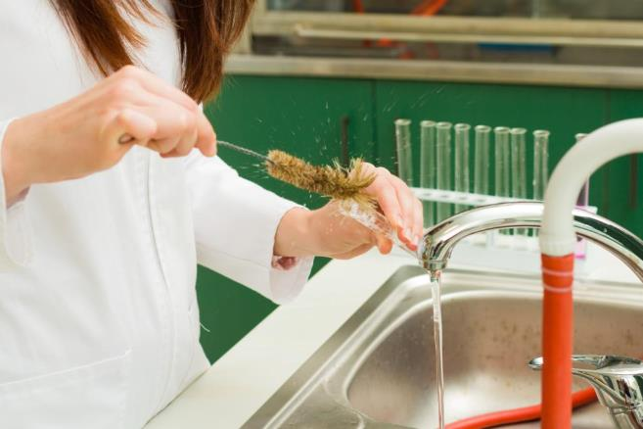
14. All equipment should be cleaned and put back in its correct place after use.

Slide 18
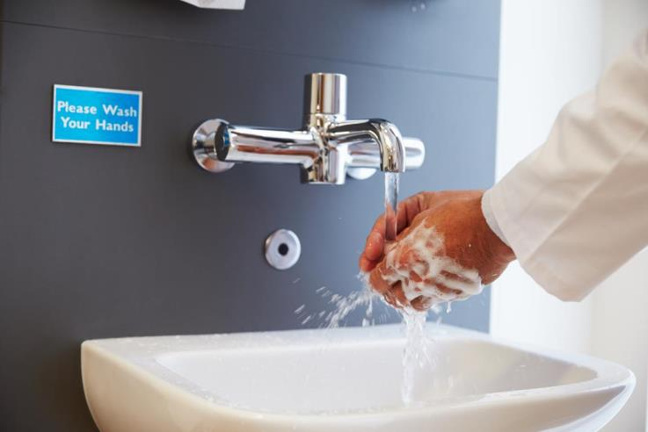
15. Always wash your hands after practical work.

Slide 19
16. Students should behave in a responsible manner at all times in the laboratory.

