Slide 3
The characteristics of all living things
Characteristic | Meaning
Cells | The basic building blocks of living things
Nutrition | The way in which living things get their food
Excretion | The way in which living things get rid of wastes that they produce
Response | The way in which living things react to changes in their surroundings
Reproduction | The way in which living things produce new living things

Slide 4
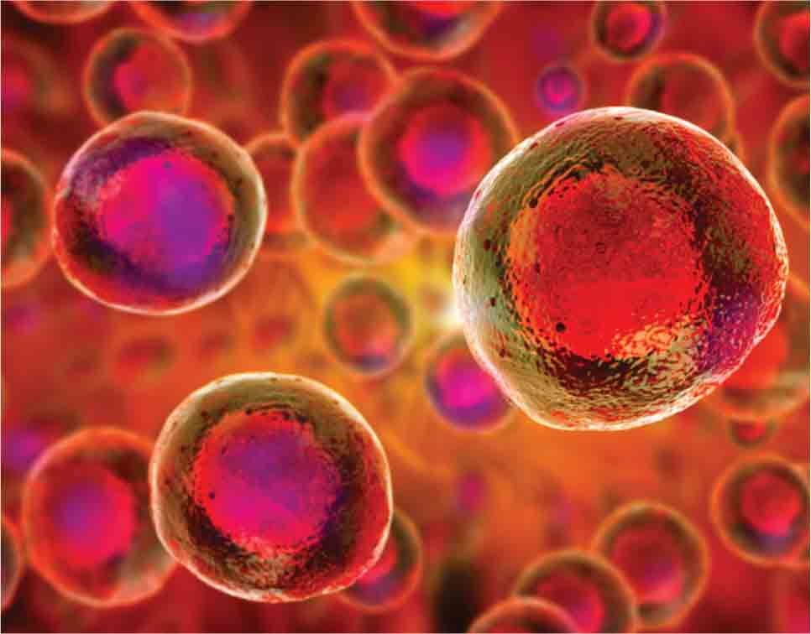
The characteristics of all living things
Living things (called organisms) must have all of the following features:
made of cells

Slide 5
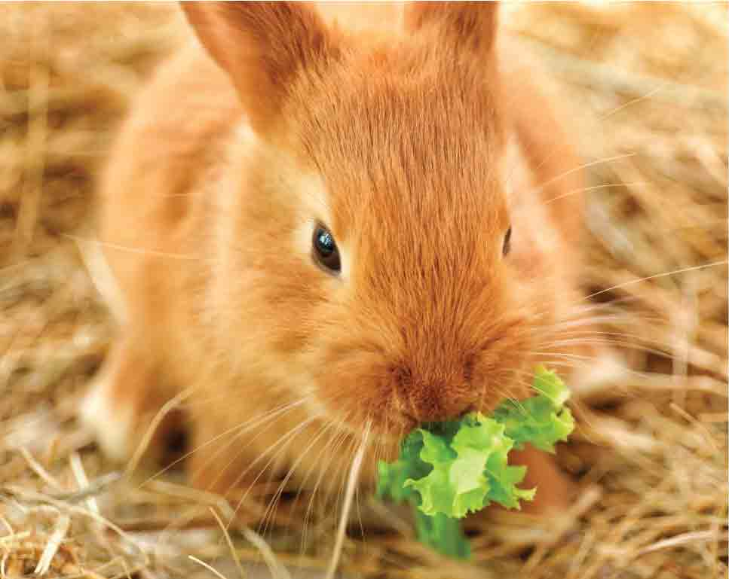
The characteristics of all living things
Living things (called organisms) must have all of the following features:
they need nutrition (or food)

Slide 6
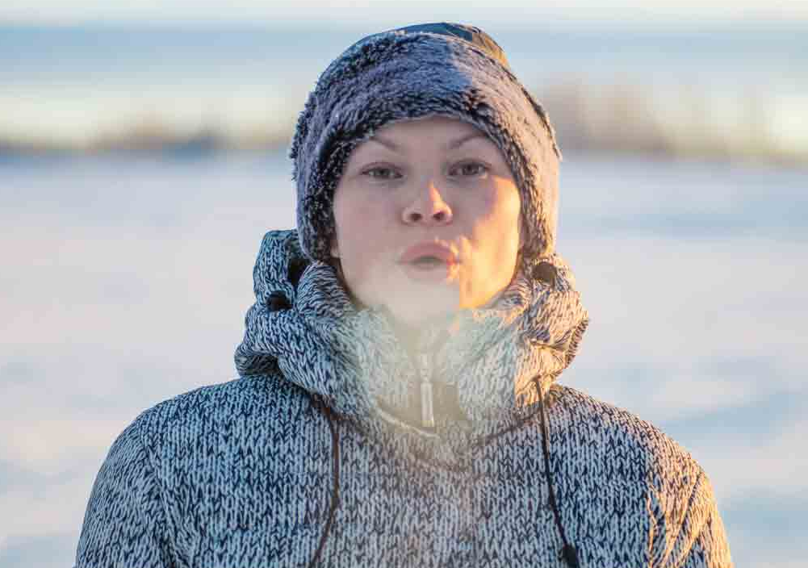
The characteristics of all living things
Living things (called organisms) must have all of the following features:
they must have excretion (getting rid of any waste that they make)

Slide 7
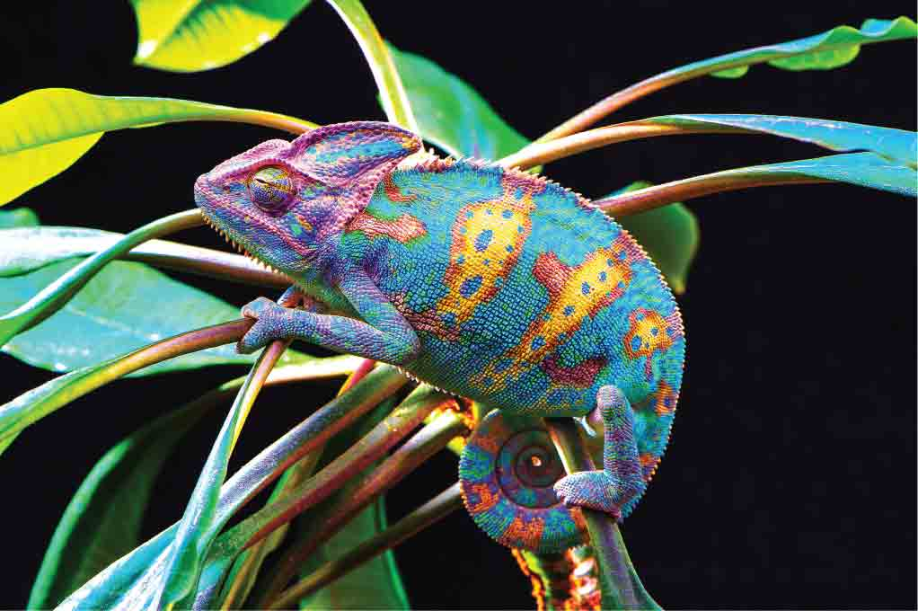
The characteristics of all living things
Living things (called organisms) must have all of the following features:
they must respond (they react to changes in their surroundings)

Slide 8
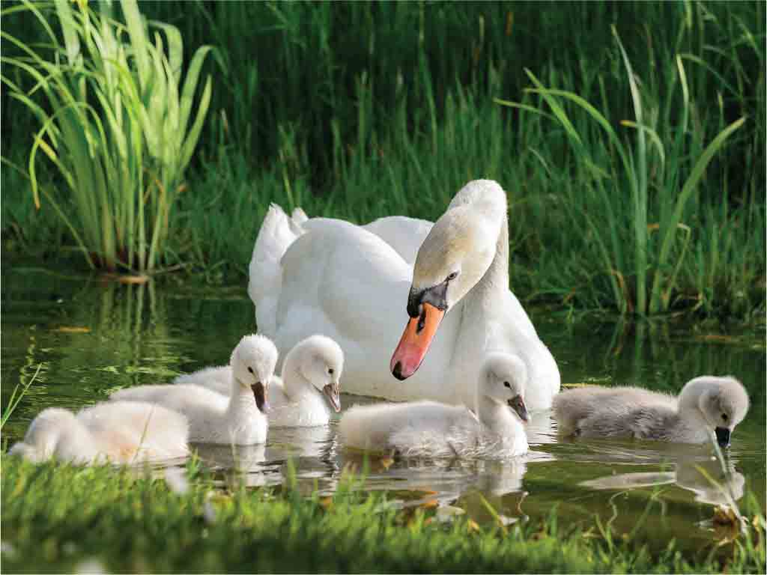
The characteristics of all living things
Living things (called organisms) must have all of the following features:
they must be able to reproduce (form new living things).

Slide 9
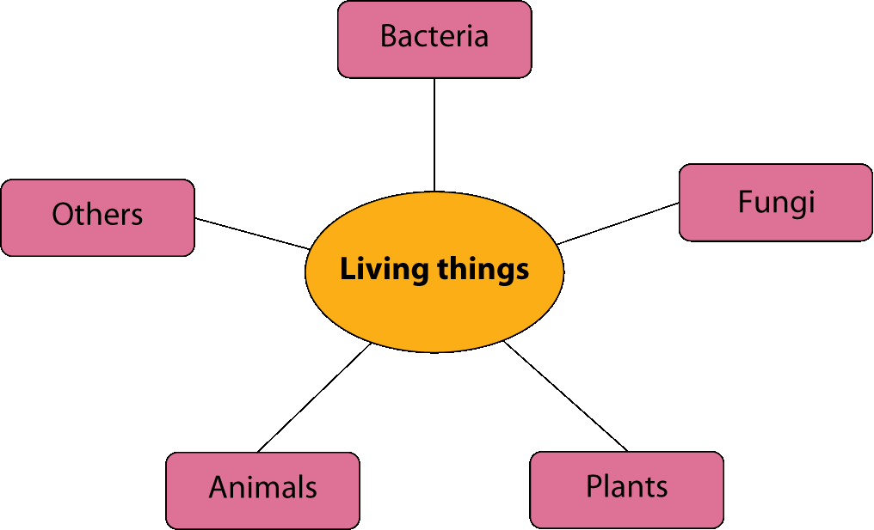
Different types of living things
To make it easier to find music on Spotify it is classified (or grouped) into headings, such as new releases or what’s hot or compilations. In the same way, living things are classified into groups.

Slide 10
Different types of living things
In general there are five major groups of living things, as shown below:
Group of living things | Examples
Bacteria | Tiny microscopic living things. Some cause disease, some cause decay, some are used to produce valuable substances
Fungi | Mushrooms, moulds and yeast
Plants | Trees, grasses, flowers
Animals | Humans, fish, insects
Others (Protists) | Seaweeds, amoeba

Slide 11
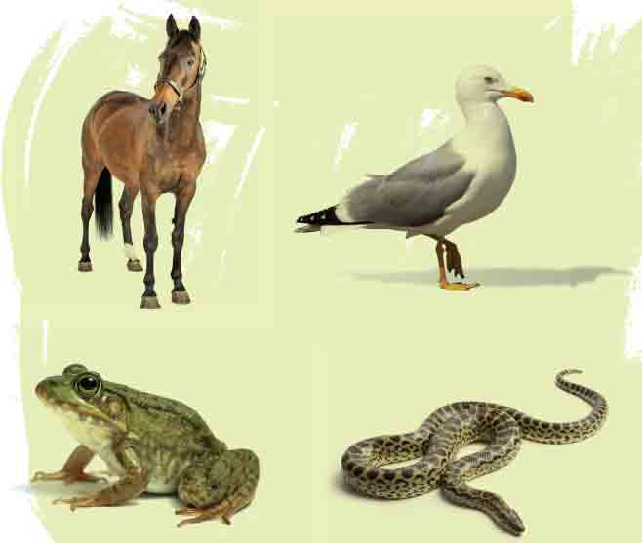
Different types of living things
Each of the five groups can be sub-divided into many smaller groupings. For example, animals can be classified as:
Vertebrates ‒ animals that have backbones (e.g. horse, seagull, frog, snake)

Slide 12
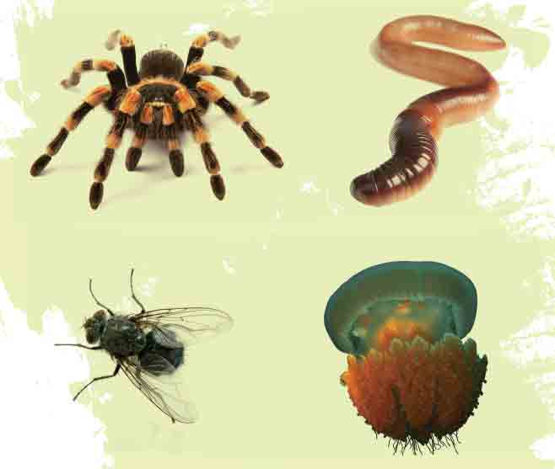
Different types of living things
Each of the five groups can be sub-divided into many smaller groupings. For example, animals can be classified as:
Invertebrates ‒ animals that do not have backbones (e.g. spider, worm, fly, jellyfish).

Slide 13
The diversity of living things
Biodiversity means the range of living things.
There is a huge range (or diversity) of living things on Earth. For example, there are many different types of plants, birds, fish and insects. Each of these living things needs special conditions in which to grow. Unfortunately, many of these conditions are being lost due to human activities.
For example:
Woodlands are destroyed for housing and roads.
Forests are being lost to supply wood for building.
Lakes are destroyed by pollution.
The resulting loss of biodiversity will be examined in chapter 12.

Slide 14
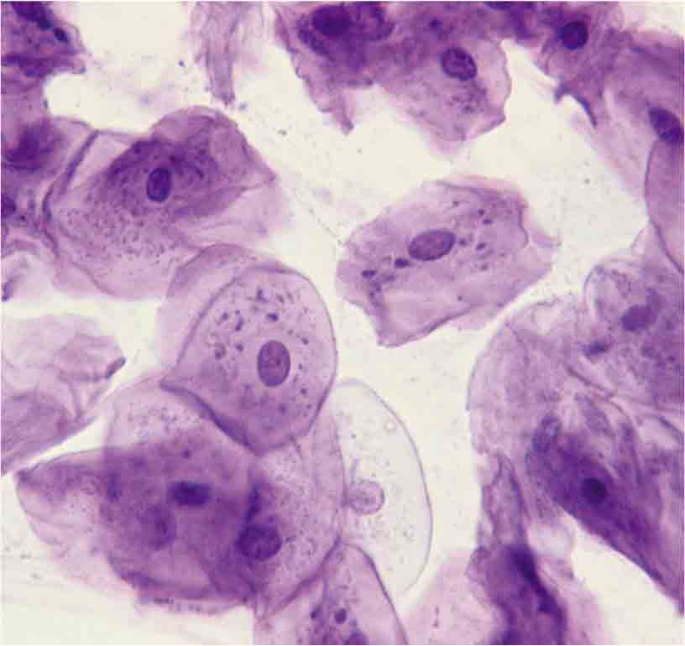
Cells
Living things are made of cells. Cells are the basic building blocks of all living things.
Most cells are too small to be seen with the naked eye. They can be seen only using a microscope.
Cells can divide to form two cells. This is called cell division. Living things grow by cell division.
For example, humans grow from a single cell (called a zygote) by cell division. As a result, an adult human has a hundred million million cells.

Slide 15
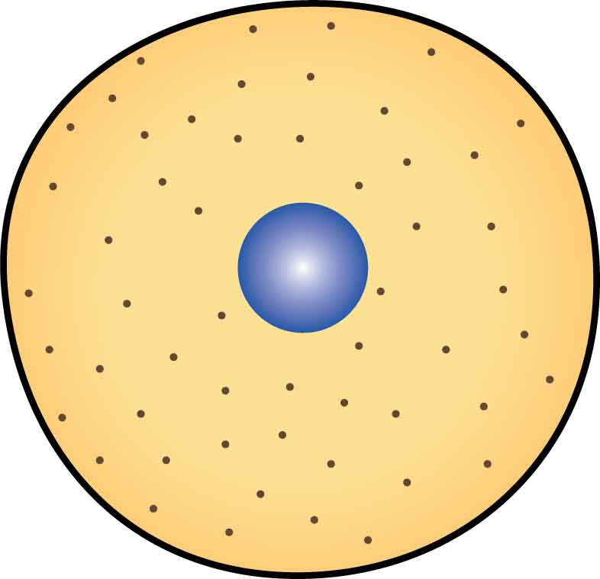
Animal cells
Animal cells have three main parts:
Cell membrane
Nucleus
Cytoplasm

Slide 16
Animal cells
Animal cells have three main parts:
Cell membrane (thin layer that surrounds cell):
holds the contents of the cell in place
controls what passes in and out of the cell.

Slide 17
Animal cells
Animal cells have three main parts:
Nucleus (a round structure that controls the cell):
contains chromosomes
chromosomes contain genes
genes are made of DNA
genes control features such as eye colour and ability to form finger nails
genes are passed on from parents to offspring.

Slide 18
Animal cells
Animal cells have three main parts:
Cytoplasm (a liquid that surrounds the nucleus):
carries out some cell reactions
contains small structures such as mitochondria (for energy).

Slide 19
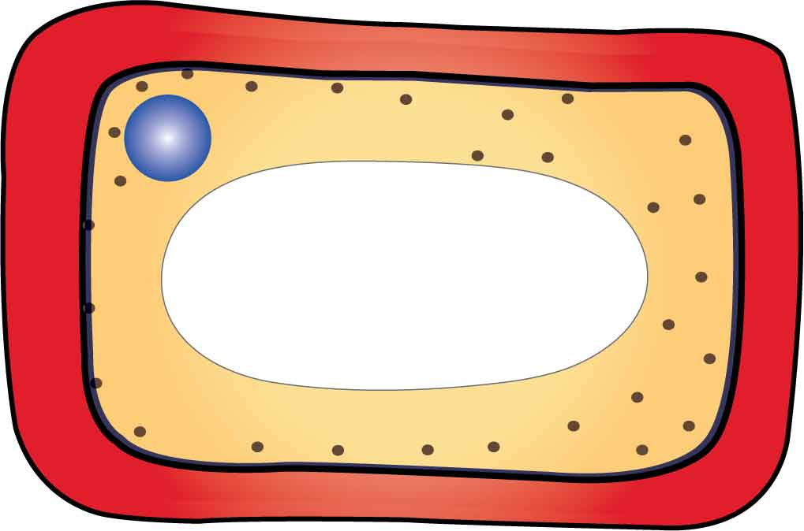
Plant cells
Plant cells have five main parts:
Cell wall
Nucleus
Cell membrane
Cytoplasm
Vacuole

Slide 20
Plant cells
Plant cells have five main parts:
A cell membrane (a thin layer that surrounds the cell):
holds the contents of the cell in place
controls what passes in and out of the cell.

Slide 21
Plant cells
Plant cells have five main parts:
A nucleus (a round structure that controls the cell)
contains chromosomes
chromosomes contain genes
genes are made of DNA
genes control features such as petal colour and the shape of the leaves
genes are passed on from parents to offspring.

Slide 22
Plant cells
Plant cells have five main parts:
Cytoplasm (a liquid that surrounds the nucleus):
carries out some cell reactions
contains small structures such as chloroplasts (for photosynthesis).

Slide 23
Plant cells
Plant cells have five main parts:
Vacuole (a small liquid-filled bag in the cytoplasm):
gives strength to plant cells.

Slide 24
Function and location of cell structures
Cell structure | Function | Found in
Cell membrane | Retains cell contents Controls what passes in and out of the cell | Animals and plants
Nucleus | The control centre of the cell | Animals and plants
Cytoplasm | Carries out some cell reactions Supports tiny cell structures | Animals and plants
Mitochondrion | Supplies energy to the cell (by respiration) | Animals and plants
Cell wall | Gives strength to the cell | Plants only
Chloroplast | Makes food (by photosynthesis) | Plants only
Vacuole | Gives strength to the cell | Plants only

Slide 25
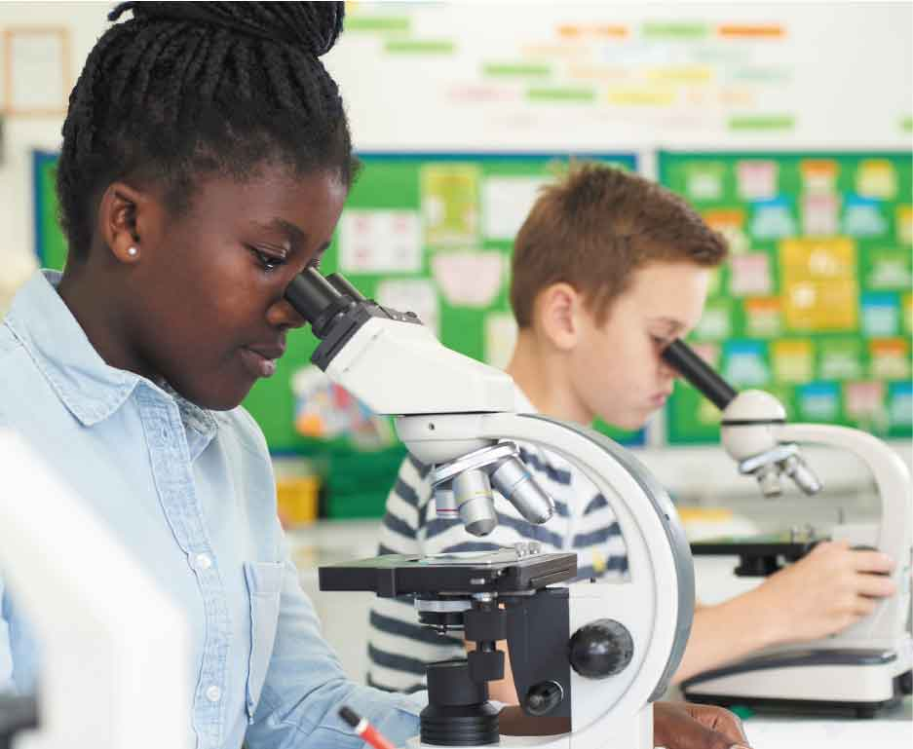
The light microscope
A microscope is used to view objects that are too small to be seen by eyesight alone.
The term ‘magnification’ means how many times larger the object appears to be when viewed under the microscope.

Slide 26
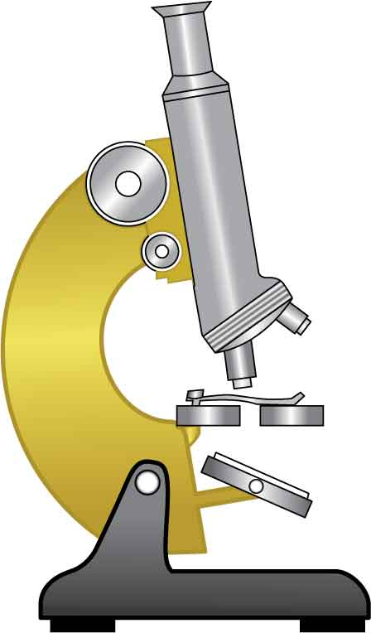
The parts of a microscope
Eyepiece lens
Coarse focus knob
Nosepiece
Fine focus knob
Objective lens
Clip
Stage
Mirror (or light)

Slide 27
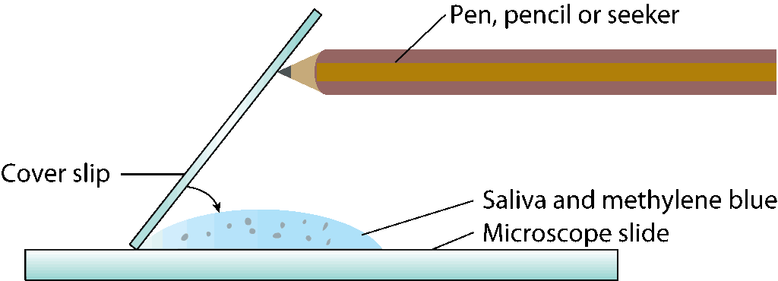
Activity 2.1 How can we examine animal cells?
Prepare the slide
Gently scrape the inside of your mouth with the cotton wool bud (or the wooden spatula).
Scrape the saliva (which now contains cheek cells) onto the centre of a microscope slide.
Add three or four drops of methylene blue stain to the saliva (this stain highlights parts of the cell, especially the nucleus).

Slide 28
Activity 2.1 How can we examine animal cells?
Prepare the slide
Lower a cover slip slowly at a 45 degree angle over the cheek cells as shown above.
Use tissue paper to soak up any of the stain that may be outside the cover slip.

Slide 29
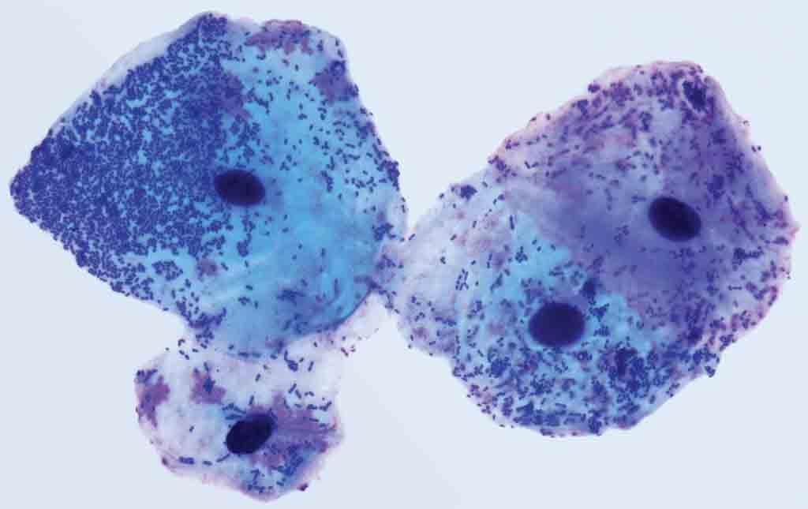
Activity 2.1 How can we examine animal cells?
Viewing the slide under a microscope
Switch on the microscope light (or adjust the mirror so that light is shining through the opening in the stage of the microscope).
Turn the nosepiece so that the lowest power objective lens is in place.
Place the slide in the centre of the microscope stage and use the clips to hold it in place.

Slide 30
Activity 2.1 How can we examine animal cells?
Viewing the slide under a microscope
Look at the stage from the side and turn the coarse focus knob so that the low power objective lens moves as close as possible to the slide. (Be careful with the lens.)
Look through the eyepiece and turn the coarse focus knob slowly so that the cells become visible.
If necessary, move the slide slightly so that you can see the best sample of cells.

Slide 31
Activity 2.1 How can we examine animal cells?
Viewing the slide under a microscope
Draw a diagram of the cells that you can see. Label the three main parts of one of the cells.
Turn the nosepiece to a higher power lens and use the fine focus knob to get a clear image of one of the cells.
Draw this cell and label three main parts.

Slide 32
Activity 2.1 How can we examine animal cells?
Viewing the slide under a microscope
Observe the cheek cells for features such as:
Are they all the same shape?
Are they all the same size?
What colour is the cytoplasm?
What colour is the nucleus?
Can you see any particles in the cytoplasm?

Slide 33
Photo credits
Michael Philips
QBS

